Slide 1
Archiving Guide
For unneeded Azure databases/apps

Slide 2
Unwanted resource groups
DMT → 12 Megabytes (MB)
DMTMobileApp → 0 MB
Equipment Tracking → 17 MB
All together these services are costing around $180.00 a month

Slide 3
The Solution -- Azure Block Blob Storage
Azure → Industry leading price point for storing rarely accessed data
Block blob storage subscription is used for streaming and storing documents, videos, pictures, backups, and other unstructured text or binary data
Access tier → Archive
Archive: The archive access tier has the lowest storage cost and higher data retrieval costs compared to hot and cool tiers. This tier is intended for data that can tolerate several hours of retrieval latency and will remain in the archive tier for at least 180 days.
While a blob is in archive storage, the blob data is offline and cannot be read, copied, overwritten, or modified. You can't take snapshots of a blob in archive storage. However, the blob metadata remains online and available, allowing you to list the blob and its properties.

Slide 4
Archive access level -- Blob Storage
Data storage prices:
Archive access tier → For the first 50 terabytes (TB) → $0.002 per gigabyte (GB) of data
Total MB of unwanted services → 29 MB → $0.000058 a month
However, if moved out before 180 days a fee will be charged

Slide 5
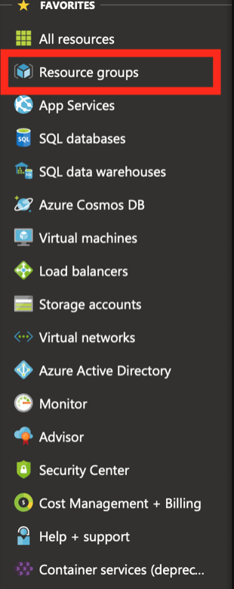
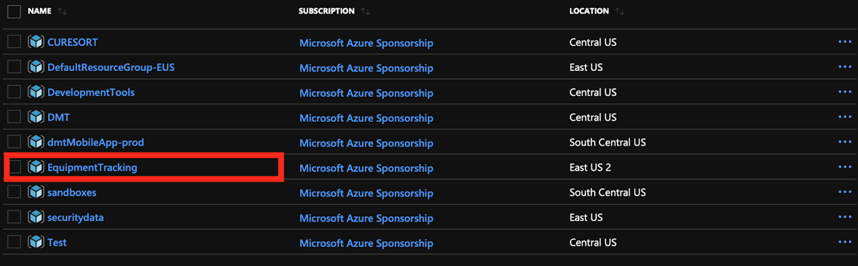
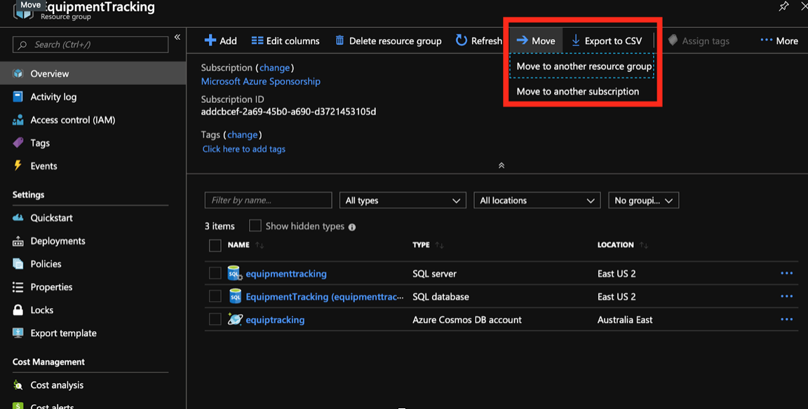
Steps to archive on Azure -- Move to Blob subscription
Step 2
Step 1
Step 3

